Slide 1
File Management
System Calls

Slide 2
System calls for files

Slide 3
System calls for files
Create new files: creat and mknod
Accessing existing files: open, read, write, lseek, and close
Manipulate the inode: chdir, chroot, chown, chmod, stat, and fstat
Advanced system calls: pipe and dup are important for the implementation of pipes
File system tree visible: mount and umount
Change the structure of the file system hierarchy: link and unlink

Slide 4
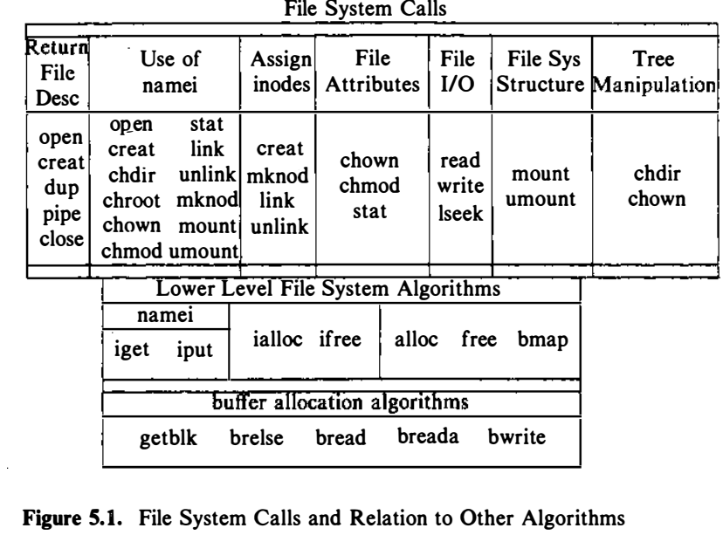
Relationship between the system calls and the various algorithms

Slide 5
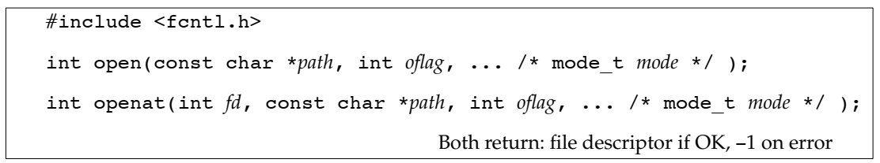
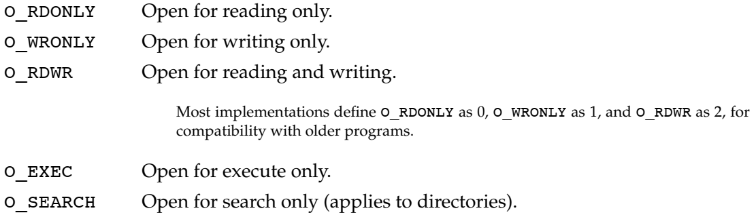
Opening a File
The path parameter is the name of the file to open or create.

Slide 6
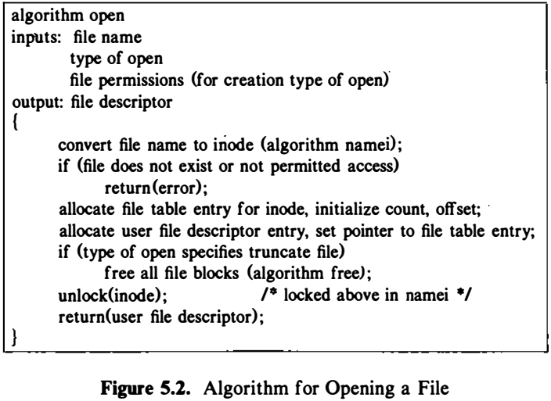
Opening a File

Slide 7
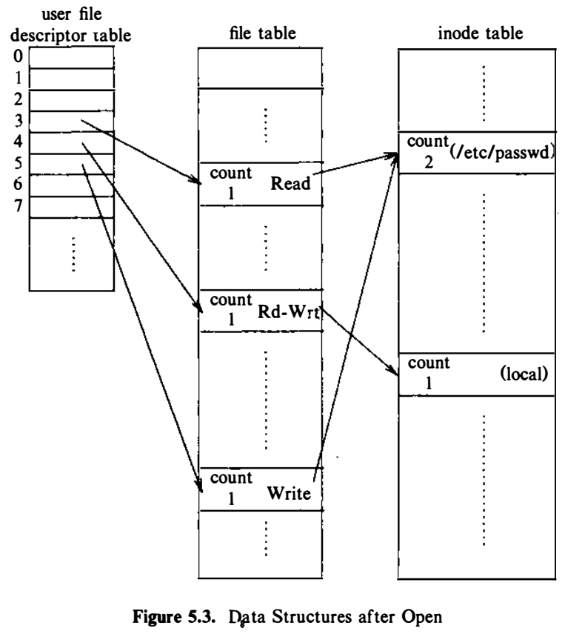
Opening a File
Process A
fd1 = open ("/etc/passwd", O_RDONLY) ;
fd2 = open ("local", 0 RDWR) ;
fd3 = open ("/etc/passwd", O_WRONLY) ;

Slide 8
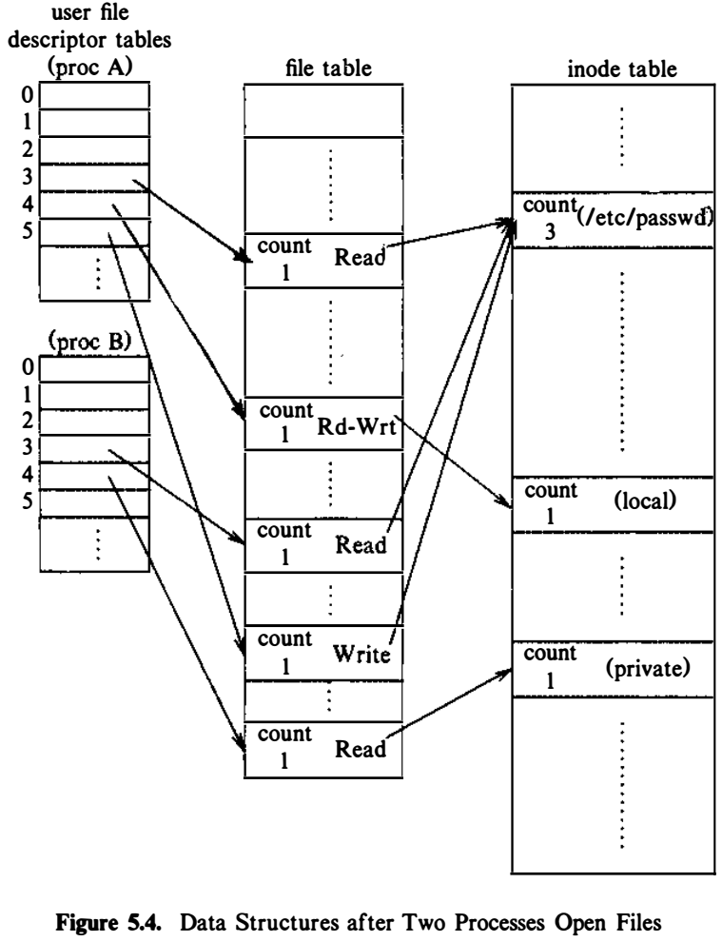
Opening a File
Process A
fd 1 = open ("/etc/passwd", O_RDONLY) ;
fd2 = open ("local", 0 RDWR) ;
fd3 = open ("/etc/passwd", O_WRONLY) ;
Process B
fd 1 = open ("/etc/passwd", O_RDONLY) ;
fd2 = open ("private", 0_RDONLY) ;

Slide 9

Create new files
Mode: defines the file's access permissions.
The mode is usually specified as an octal number such as 0666 that would mean read/write permission for owner, group.
constants for the mode argument as defined in sys/stat.h
#define S_IREAD 0000400 read permission, owner
#define S_IWRITE 0000200 write permission, owner
#define S_IRGRP 0000040 read permission, group
#define S_IROTH 0000004 read permission, other

Slide 10
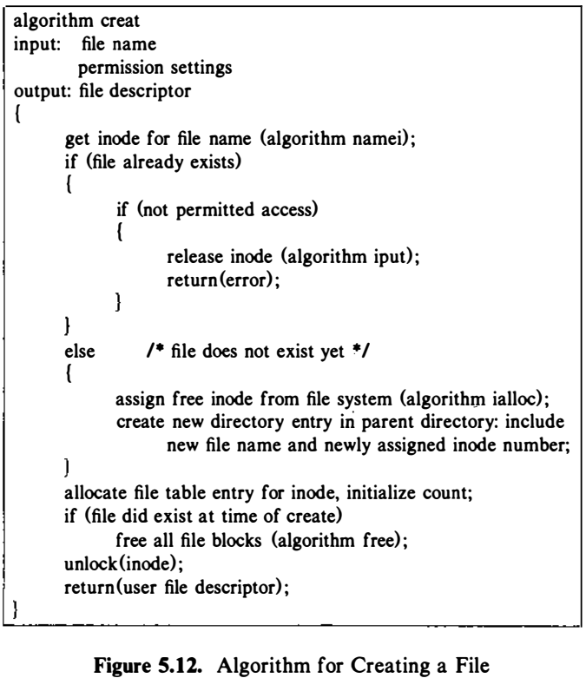
Algorithm to create a file

Slide 11
Create new files
Only the superuser has the permission to use the mknod() system call to create a new directory
an ordinary user cannot use mknod() to create a directory.
we use fork/exec to call upon the UNIX system's mkdir command that anyone can use to create a directory.

Slide 12
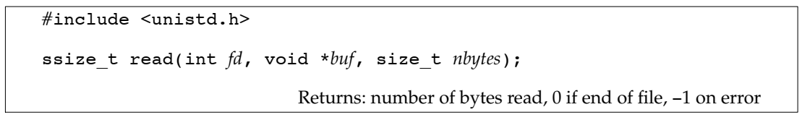
Read a file
fd file descriptor identifies the I/O channel. fd returned by open()
buf buffer pointer points to the area in memory where the data is stored.
nbytes is the number of bytes the user wants to read.
read() returns the number of bytes actually read().

Slide 13
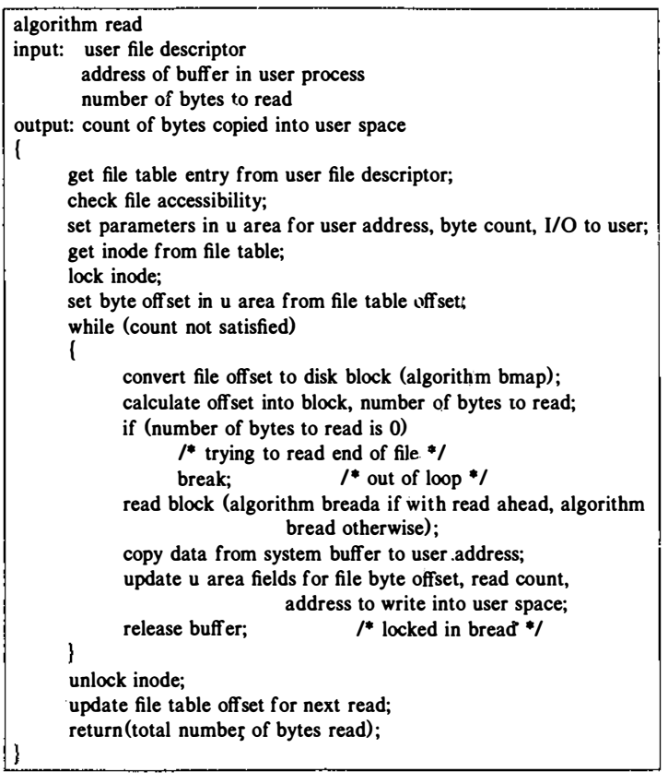
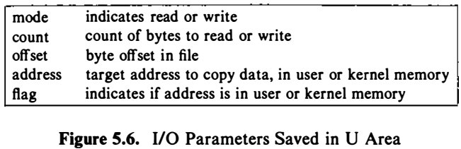
Algorithm for Reading a File

Slide 14
Accessing existing files
There are several cases in which the number of bytes actually read is less than the amount requested:
Reading from a regular file,
If the end of file is reached before the requested number of bytes has been read.
For example, if 30 bytes remain until the end of file and we try to read 100 bytes, read returns 30.
Reading from a terminal device
Normally, up to one line is read at a time.
Reading from a network
Buffering within the network may cause less than the requested amount to be returned.
Reading from a pipe or FIFO
If the pipe contains fewer bytes than requested, read will return only what is available.

Slide 15
Accessing existing files
Treats an ordinary file as a sequence of bytes.
Generally, a file is read or written sequentially -- that is, from beginning to the end of the file.
Sometimes sequential reading and writing is not appropriate.
The UNIX system lets you read and write anywhere in the file known as "random access“.
This capability is made possible with the lseek() system call.
Random access I/O is achieved by changing the value of this file pointer using the lseek() system call.

Slide 16
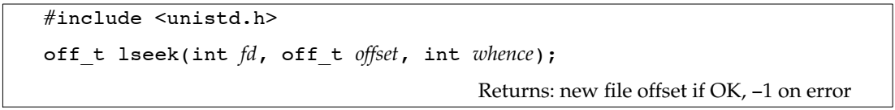
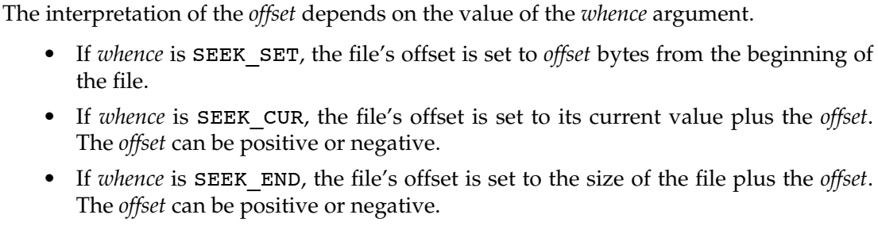
lseek function

Slide 17
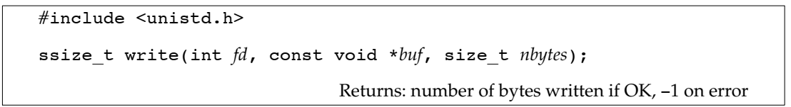
Write function
int write(int fd, char *buf, unsigned nbytes);
The return value is usually equal to the nbytes argument; otherwise, an error has occurred.
For a regular file, the write operation starts at the file’s current offset.
After a successful write, the file’s offset is incremented by the number of bytes actually written.

Slide 18
Accessing existing files
Every open file has an associated "current file offset"
#include <unistd.h>
int lseek(int fd, off_t offset, int whence);
Returns: new file offset if OK, −1 on error
The interpretation of the offset depends on the value of the whence argument.
0 (or SEEK_SET) offset bytes into the file
1 (or SEEK_CUR) current position in the file plus offset
2 (or SEEK_END) current end-of-file position plus offset.
If successful, lseek() returns a long integer that defines the new file pointer value measured in bytes from the beginning of the file.
If unsuccessful, the file position does not change.

Slide 19
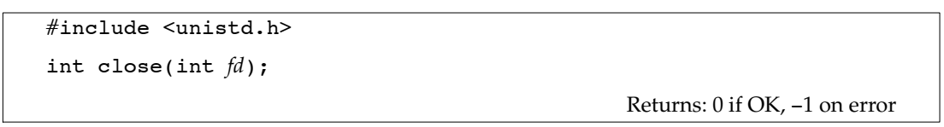
Close a file
fd returned by open()
Closing a file also releases any record locks that the process may have on the file.
When a process terminates, all of its open files are closed automatically by the kernel.

Slide 20
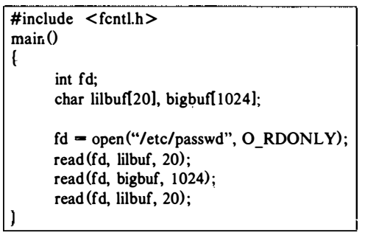
Reading: Example (1)

Slide 21
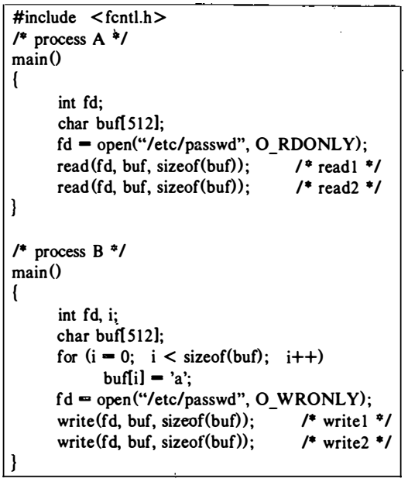
Read & write: Example (2)

Slide 22
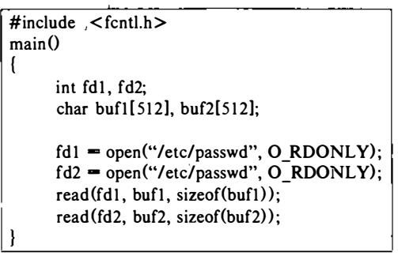
Read: Example (3)

Slide 24
Writing
Suppose a process writes byte number 10,240 to a file?

Slide 25
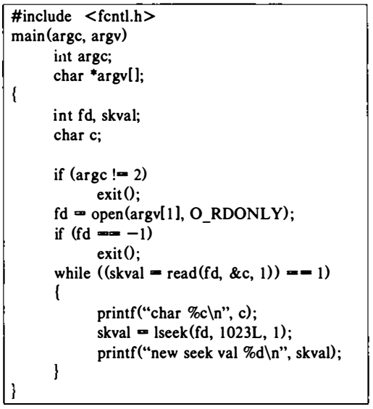
lseek: Example (4)

Slide 26
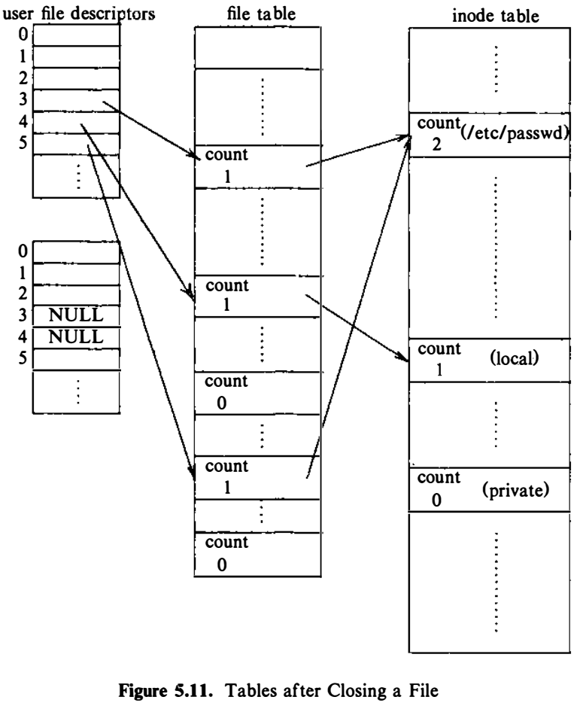
Process B closes files

Slide 27
Accessing existing files
An open file is closed by calling the close function. #include <unistd.h>
int close(int fd);
Returns: 0 if OK, −1 on error
where fd file descriptor identifies a currently open channel.
close() fails if file descriptor does not identify a currently open channel.
Closing a file also releases any record locks that the process may have on the file.
When a process terminates, all of its open files are closed automatically by the kernel.

Slide 28
System calls for files
create new files: creat and mknod
accessing existing files: open, read, write, lseek, and close
manipulate the inode: chdir, chroot, chown, chmod, stat, and fstat
advanced system calls: pipe and dup are important for the implementation of pipes
file system tree visible: mount and umount
change the structure of the file system hierarchy: link and unlink

Slide 29
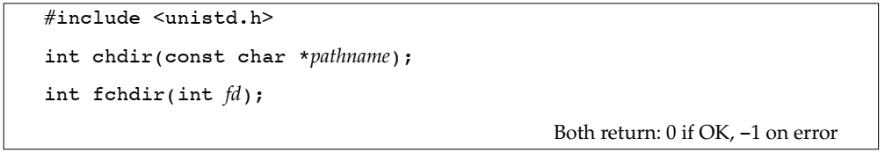
chdir
We can specify the new current working directory either as a pathname or through an open file descriptor.

Slide 30
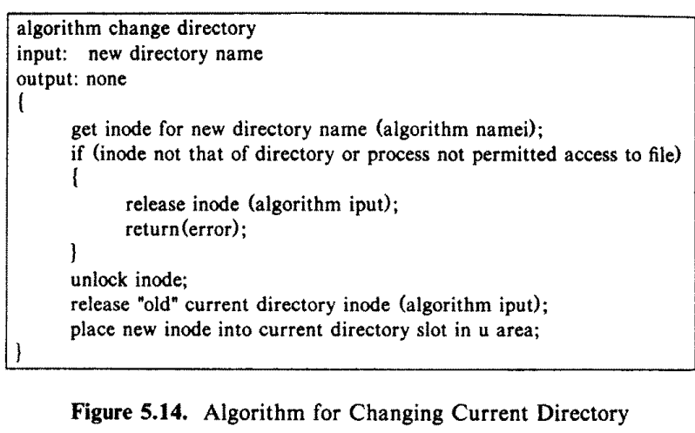
Algorithm for chdir

Slide 31
chroot
Processes can change their notion of the file system root via the chroot system call.
This is useful if a user wants to simulate the usual file system hierarchy and run processes there.
chroot(pathname);
where pathname is the directory that the kernel subsequently treats as the process's root directory.
When executing the chroot system call, the kernel follows the same algorithm as for changing the current directory.

Slide 32
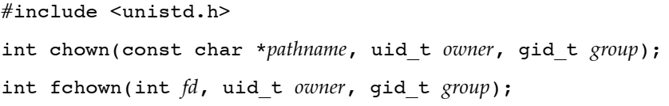

chown
To change the owner of a file, the kernel converts the file name to an inode.
The kernel assigns the new owner and group to the file, clears the set user and set group flags, and releases the inode.

Slide 33

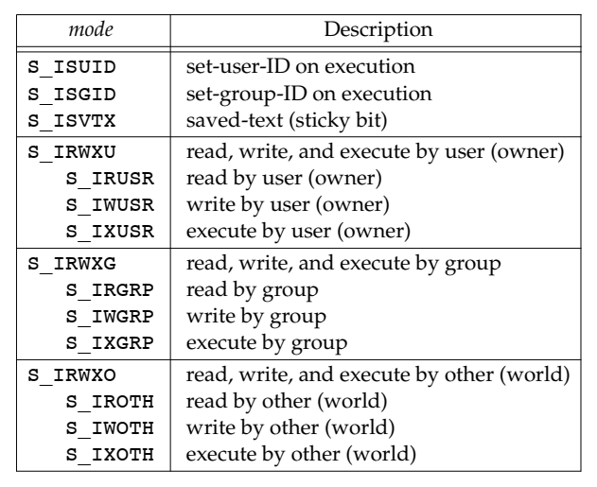
chmod

Slide 34
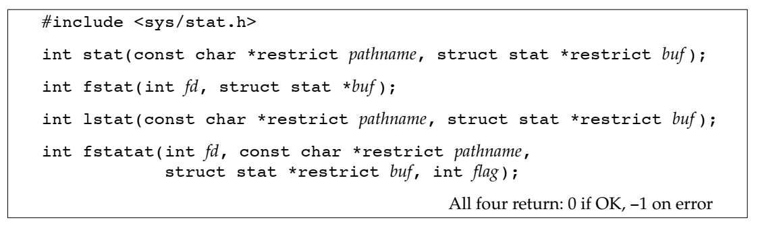
stat and fstat
The system calls stat and fstat allow processes to query the status of files, returning information such as the file type, file owner, access permissions, file size, number of links, inode number, and file access times.
Given a pathname, the stat function returns a structure of information about the named file. The fstat function obtains information about the file that is already open on the descriptor fd.

Slide 35
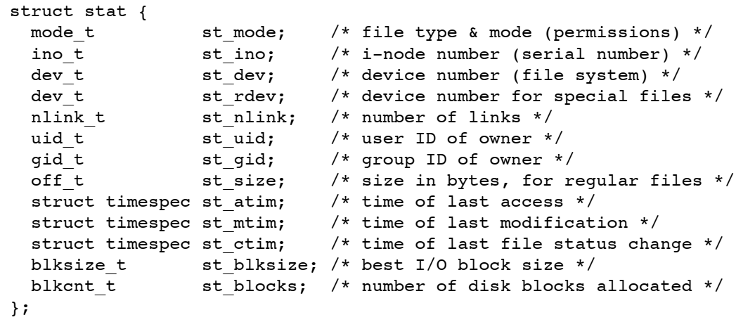
stat and fstat

Slide 36
Creation of Special Files
To create pipes, device files, and directories
Similar to creat
The kernel allocates an inode for the file
mknod(pathname, type and permissions, dev)
where
pathname is the name of the node to be created,
type and permissions give the node type (directory, for example) and access permissions for the new file to be created, and
dev specifies the major and minor device numbers for block and character special files

Slide 37
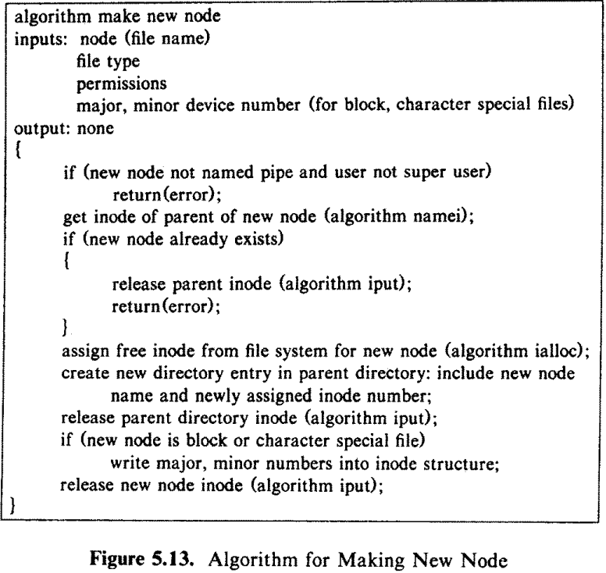
Algorithm for mknod

Slide 38
System calls for files
create new files: creat and mknod
accessing existing files: open, read, write, lseek, and close
manipulate the inode: chdir, chroot, chown, chmod, stat, and fstat
advanced system calls: pipe and dup are important for the implementation of pipes
file system tree visible: mount and umount
change the structure of the file system hierarchy: link and unlink

Slide 39
Advanced System Calls
Pipes allow transfer of data between processes in a first-in-first-out manner (FIFO),
Allow synchronization of process execution.
Two kinds of pipes:
Named pipes and
Unnamed pipes

Slide 40
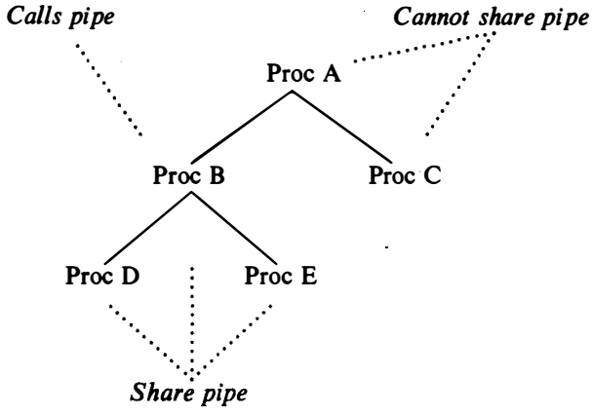
Advanced System Calls
Descendants of a process that issued the pipe call, can share access to unnamed pipes.
All processes can access a named pipe regardless of their relationship, subject to the usual file permissions.
Figure 5.15: Process Tree and Sharing Pipes

Slide 41
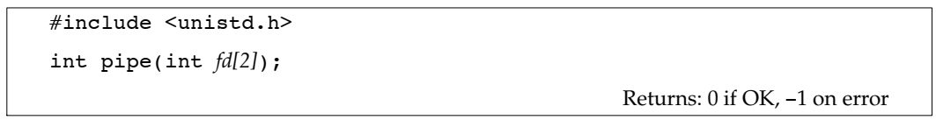
Advanced System Calls
where Two file descriptors are returned through the fd argument: fd[0] is open for reading, and fd[1] is open for writing. The output of fd[1] is the input for fd[0].
It also allocates a pair of user file descriptors and corresponding file table entries for the pipe:
one file descriptor for reading from the pipe
the other for writing to the pipe.
The kernel allocates two file table entries for the read and write descriptors, respectively.

Slide 42
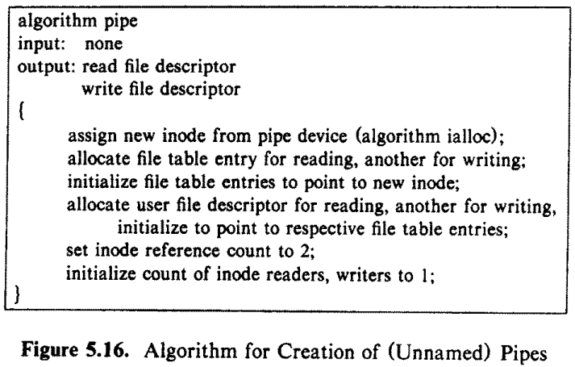
Algorithm for pipe

Slide 43
Opening a named file
A named pipe is a file whose semantics are the same as those of an unnamed pipe, except that it has a directory entry and is accessed by a path name.
Processes open named pipes in the same way that they open regular files.
Named pipes permanently exist in the file system hierarchy (subject to their removal by the unlink system call),
Unnamed pipes are transient: When all processes finish using the pipe, the kernel reclaims its inode.

Slide 44
The algorithm for opening a named pipe
Identical to the algorithm for opening a regular file.
However, before completing the system call, the kernel increments the read or write counts in the inode, indicating the number of processes that have the named pipe open for reading or writing.
A process that opens the named pipe for reading will sleep until another process opens the named pipe for writing, and vice versa.
Sleep or signal
Read/write

Slide 45
Reading and Writing Pipes
FIFO
Processes write into one end of the pipe and read from the other end
The number of processes reading from a pipe do not necessarily equal the number of processes writing the pipe;
If the number of readers or writers is greater than 1, they must coordinate use of the pipe with other mechanisms.
The kernel accesses the data for a pipe exactly as it accesses data for a regular file.
It stores data on the pipe device and assigns blocks to the pipe as needed during write calls.

Slide 46
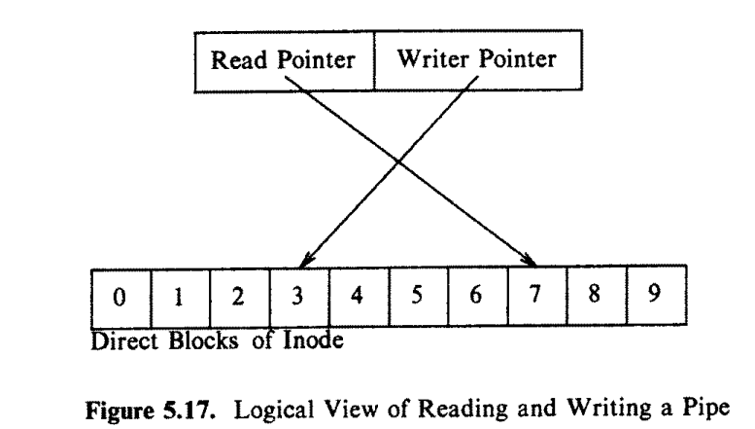
Reading and Writing Pipes (contd…)
Difference:
A pipe uses only the direct blocks of the inode for greater efficiency, although this places a limit on how much data a pipe can hold at a time.
Circular queue,

Slide 47
Reading and Writing Pipes (contd…)
Four cases for reading or writing:
Writing a pipe that has room for the data being written,
Reading from a pipe that contains enough data to satisfy the read,
Reading from a pipe that does not contain enough data to satisfy the read, and
Writing a pipe that does not have room for the data being written.
The implementation of pipes,
The process interface is consistent with that of regular files,
The implementation differs because the kernel stores the read and write offsets in the inode instead of in the file table

Slide 48
Closing Pipes
Follow for closing a regular file, except that the kernel does special processing before releasing the pipe's Mode.

Slide 49
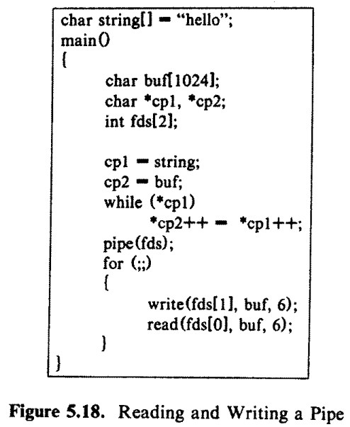
Pipe: Example (1)

Slide 50
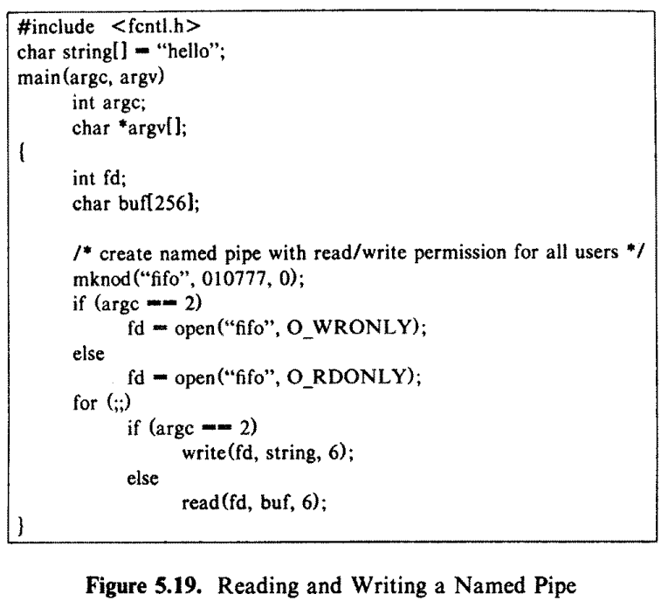
Pipe: Example (2)

Slide 51
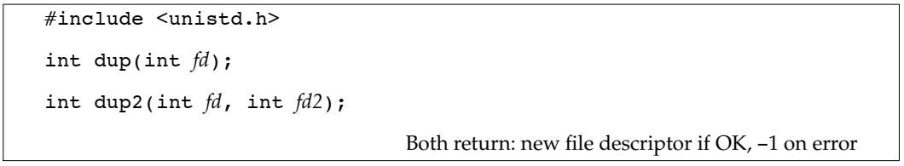
Advanced System Calls
Copies a file descriptor into the first free slot of the user file descriptor table, returning the new file descriptor to the user.
where
fd is the file descriptor being duped
newfd is the new file descriptor that references the file.
dup duplicates the file descriptor, it increments the count of the corresponding file table entry, which now has one more file descriptor entry that points to it.

Slide 52
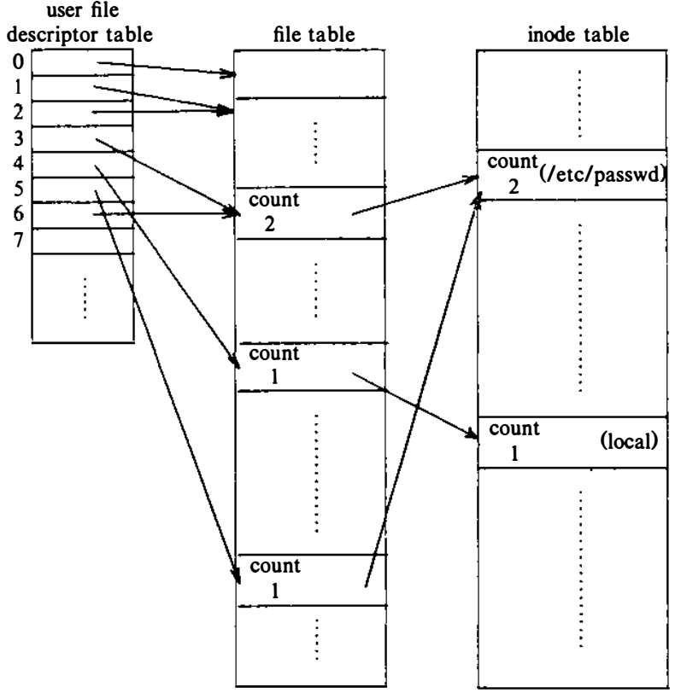
Advanced System Calls
Duped file descriptor (fd) 3, return fd 6
Fig: Data Structures after Dup

Slide 53
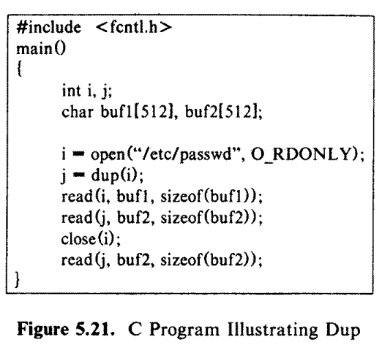
Dup: example

Slide 54
System calls for files
create new files: creat and mknod
accessing existing files: open, read, write, lseek, and close
manipulate the inode: chdir, chroot, chown, chmod, stat, and fstat
advanced system calls: pipe and dup are important for the implementation of pipes
file system tree visible: mount and umount
change the structure of the file system hierarchy: link and unlink

Slide 55
File System Tree Visible
A physical disk unit consists of several logical sections, partitioned by the disk driver, and each section has a device file name.
Processes can access data in a section by opening the appropriate device file name and then reading and writing the "file," treating it as a sequence of disk blocks.
The mount system can connects the file system in a specified section of a disk to the existing file system hierarchy.

Slide 56
File System Tree Visible
The syntax for the mount system can is
mount (special pathname, directory pathname, options);
where special pathname is the name of the device special file of the disk section containing the file system to be mounted
directory pathname is the directory in the existing hierarchy where the file system will be mounted
options indicate whether the file system should be mounted “read-only”, etc.
The kernel only allows processes owned by a superuser to mount or umount file systems

Slide 57
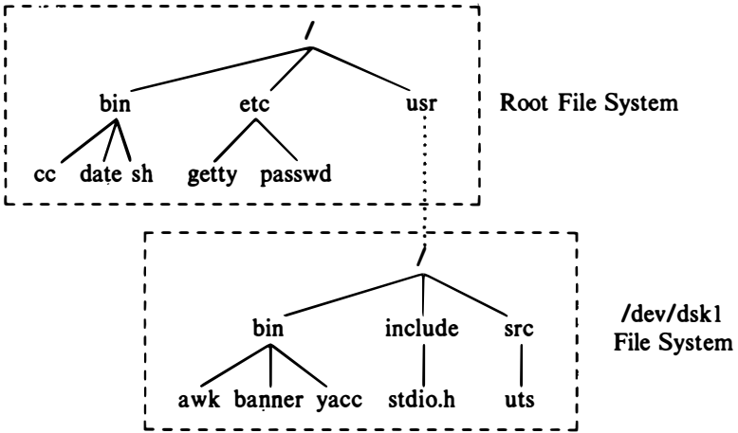
File System Tree Visible
Example mount (“/dev/dskl ", "/usr", 0) ;
Fig: File System Tree Before and After Mount

Slide 58
File System
The kernel has a mount table with entries for every mounted file system. Each mount table entry contains:
a device number that identifies the mounted file system
a pointer to a buffer containing the file system super block
a pointer to the root inode of the mounted file system ("/" of the "/dev/dskl " file system) ;
a pointer to the inode of the directory that is the mount point ("usr" of the root file system) .

Slide 59
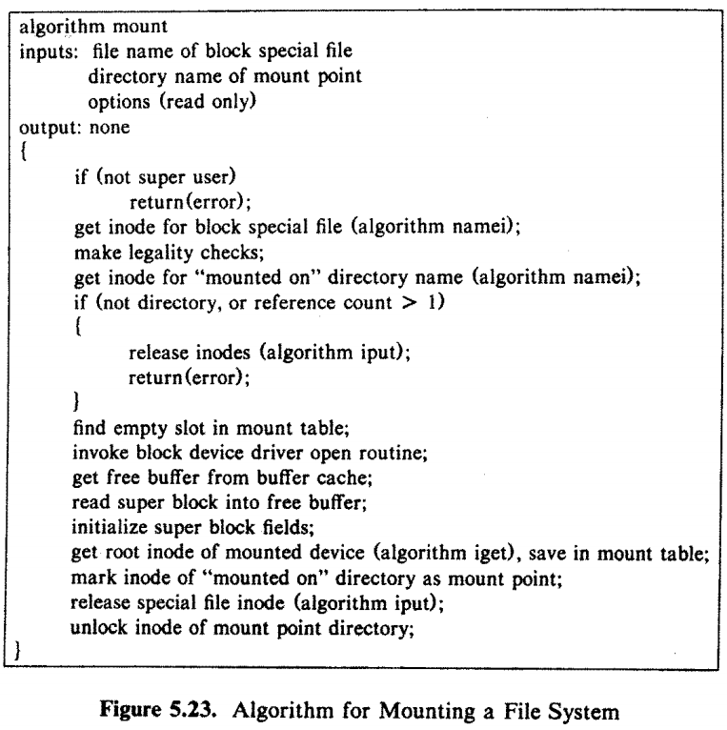
Algorithm for mount

Slide 60
Crossing mount points in File Path names
Two cases:
Crossing from the mounted-on file system to the mounted file system (in the direction from the global system root towards a leaf node)
Crossing from the mounted file system to the mounted-on file system

Slide 61
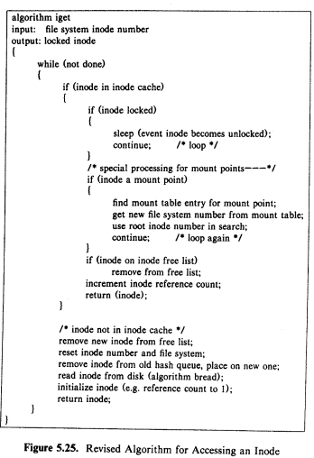
Updated iget algo

Slide 62
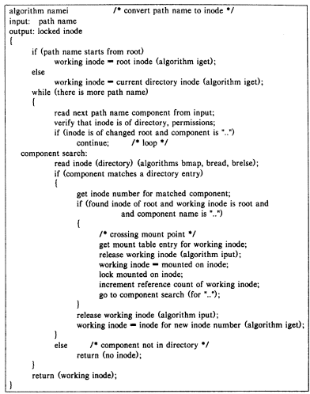
Updated namei algo

Slide 63
File System Tree Visible
The syntax for the unmount system can is
umount(special filename);

Slide 64
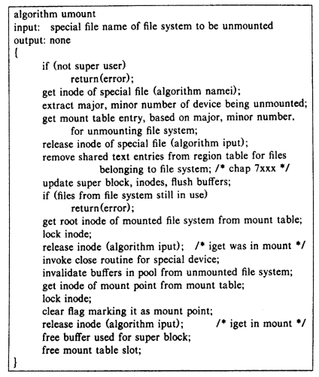
Algorithm for unmount

Slide 65
System calls for files
Create new files: creat and mknod
Accessing existing files: open, read, write, lseek, and close
Manipulate the inode: chdir, chroot, chown, chmod, stat, and fstat
Advanced system calls: pipe and dup are important for the implementation of pipes
File system tree visible: mount and umount
Change the structure of the file system hierarchy: link and unlink

Slide 66
System call: link
The link system call links a file to a new name in the file system directory structure, creating a new directory entry for an existing inode
link(source file name, target file name) ;
where source file name is the name of an existing file and
target file name is the new (additional) name the file will have after completion of the link call.

Slide 67
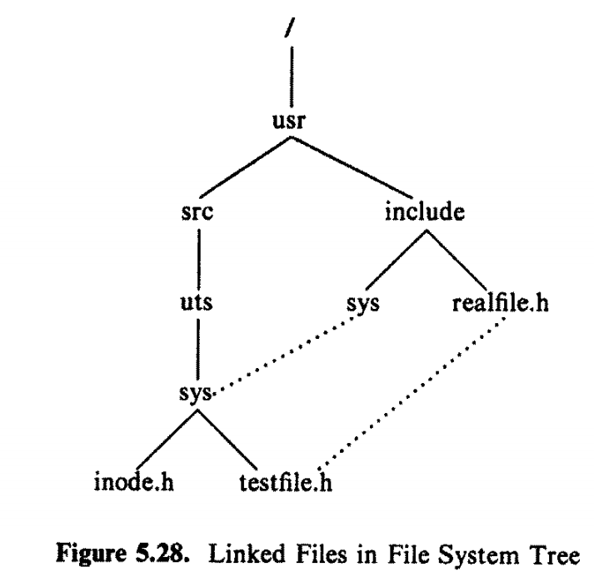

Example of Link

Slide 68
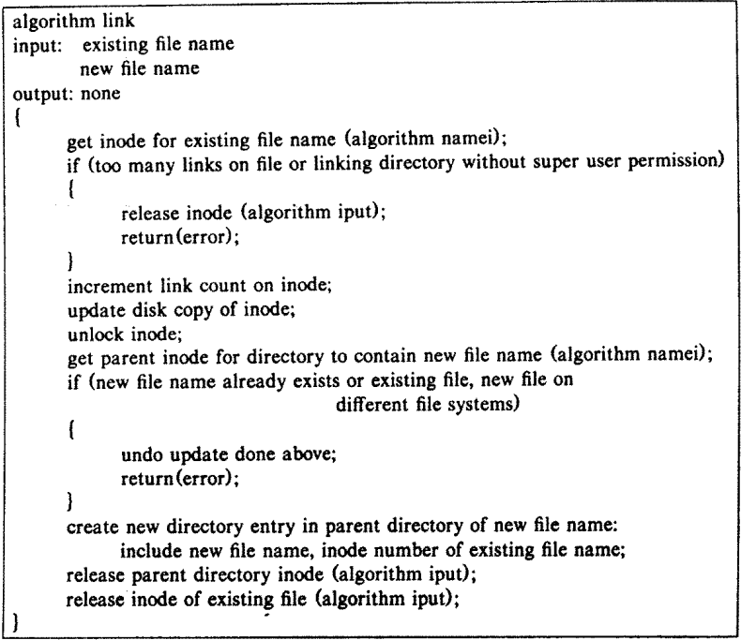
Algorithm of link

Slide 69
System call: unlink
The unlink system call removes a directory entry for a file.
unlink(pathname);
where pathname identifies the name of the file to be unlinked from the directory hierarchy.

Slide 70
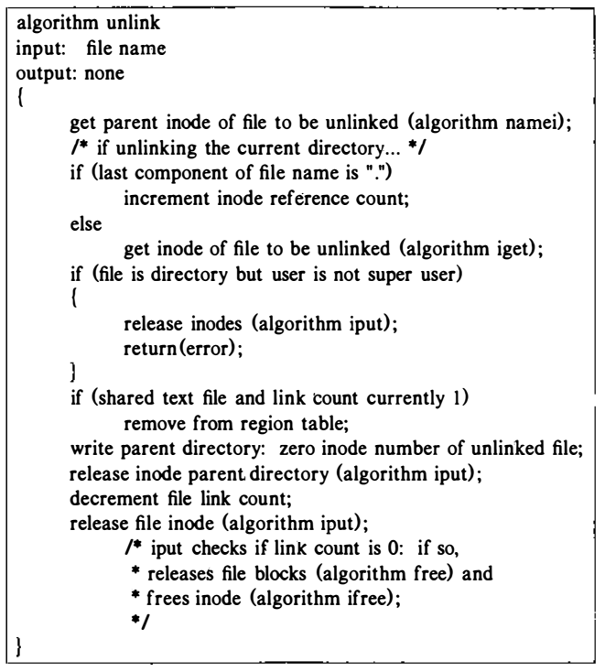
Algorithm for unlinking

Slide 71
Scenario
Suppose a file has two links with path names "a" and "b", and suppose a process unlinks "a“
Steps:

Slide 72
File System Maintenance
The kernel maintains consistency of the file system during normal operation.
However, extraordinary circumstances such-as a power failure may cause a system crash that leaves a file system in an inconsistent state.
The command fsck checks for such inconsistencies and repairs the file system if necessary.

Slide 73
File System Maintenance
The file system loses its integrity. Here are some common discrepancies:
Two or more inodes claiming the same disk block.
A block marked as free, but not listed in the superblock.
A used block marked as free.
Mismatch between the file size specified in the inode and the number of data blocks specified in the address array.
A file not having at least one directory entry or having an invalid file type specified in the inode.

Slide 74
File System Maintenance: discrepancy (1)
Two or more inodes claiming the same disk block.
Scenario:
If the kernel freed a disk block in a file, returning the block number to the in-core copy of the super block, and allocated the disk block to a new file.
If the kernel wrote the inode and blocks of the new file to disk but crashed before updating the inode of the old file to disk, the two inodes would address the same disk block number.
Similarly, if the kernel wrote the super block and its free list to disk and crashed before writing the old inode out, the disk block would appear on the free list and in the old inode.

Slide 75
File System Maintenance: discrepancy (2)
If a block number is not on the free list of blocks nor contained in a file, the file system is inconsistent because.
Scenario:
If a block was removed from a file and placed on the super block free list.
If the old file was written to disk and the system crashed before the super block was written to disk, the block would not appear on any lists stored on disk.

Slide 76
File System Maintenance: discrepancy (3)
An inode may have a non-zero link count, but its inode number may not exist in any directories in the file system.
Scenario:
All files except (unnamed) pipes must exist in the file system tree.
If the system crashes after creating a pipe or after creating a file but before creating its directory entry, the inode will have its link field set even though it does not appear to be in the file system.
If a directory were unlinked before making sure that all files contained in the directory were unlinked.

Slide 77
File System Maintenance: discrepancy (4)
If the format of an inode is incorrect (for instance, if the file type field has an undefined value) , something is wrong.
Scenario:
This could happen if an administrator mounted an improperly formatted file system. The kernel accesses disk blocks that it thinks contain inodes but in reality contain data.

Slide 78
File System Maintenance: discrepancy (5)
If an inode number appears in a directory entry but the inode is free, the file system is inconsistent because an inode number that appears in a directory entry should be that of an allocated inode.
Scenario:
If the kernel was creating a new file and wrote the directory entry to disk but did not write the inode to disk before the crash.
If a process unlinked a file and wrote the freed inode to disk, but did not write the directory element to disk before it crashed.

Slide 79
File System Maintenance
The fsck (file system consistency check) command is used to check and repair a damaged file system.
The command generally acts as a frontend to the file system–specific program that actually does the job.
It’s generally run when a file system fails to mount.
On many systems, including Solaris, file systems are marked as “dirty” or “clean.”
fsck then checks only the dirty file systems during the next startup.

Slide 80
File System Maintenance
fsck conducts a check in five phases
Phase 1 - Check Blocks and Sizes
Phase 2 - Check Pathnames
Phase 3 - Check Connectivity
Phase 4 - Check Reference Counts
Phase 5 - Check Free List
When, fsck checks consistent. If it is corrupt, messages and questions, which you have to answer correctly, are seen on the system console.

Slide 81
Reference
The Design of the UNIX Operating System, by Maurice J. Bach

